Slide 1
Spark on HDInsight SparkML
Ali Zaidi
Data Scientist
Machine Learning Education Team

Slide 2

Learning objectives
Apache Spark Machine Learning library (MLlib)
Distinguishing between SparkMLLib and Spark ML
Spark ML Pipelines

Slide 3
MLlib vs ML

Slide 4

What is MLlib (spark.mllib)?
Q
MLlib is a collection of machine learning algorithms optimized to run in a parallel, distributed manner on Spark clusters.
MLlib works with the lower-level RDD API
In maintenance mode since Spark 2.0
MLlib applications are developed in Java, Scala, Python and R.
A
Notes:
Objective: This slide describes what MLlib is and the types of algorithms it supports.
Talking points:
A collection of machine learning algorithms optimized to run in a parallel, distributed manner on Spark clusters. Leads to better performance on large data sets.
It integrates seamlessly with other Spark components.
MLlib applications are developed in Java, Scala, and Python.
There are three types of machine learning algorithms: supervised, unsupervised, and recommendation.

Slide 5
What is SparkML (spark.ml)?
Q
SparkML is the newer, preferred API for machine learning
SparkML builds on top of the higher-level DataFrames API
Optimizations through Tungsten and Catalyst
Inputs to many operations, pipelines
Allows for versatile storage
Easy to pipeline other ML applications (scoring, visualization, etc)
A
Notes:
Objective: This slide describes what MLlib is and the types of algorithms it supports.
Talking points:
A collection of machine learning algorithms optimized to run in a parallel, distributed manner on Spark clusters. Leads to better performance on large data sets.
It integrates seamlessly with other Spark components.
MLlib applications are developed in Java, Scala, and Python.
There are three types of machine learning algorithms: supervised, unsupervised, and recommendation.

Slide 6
ML Transformers and Estimators

Slide 7
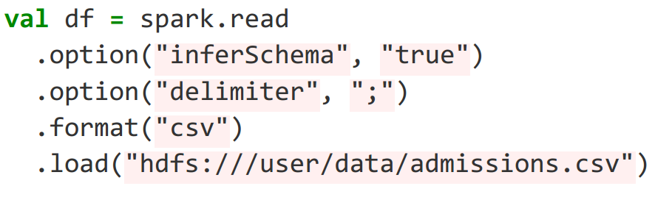
Loading Data Spark SQL (DataSets/DataFrames)
Key data structure for SparkML pipelines are DataFrames
sparkSession.read returns a DataFrameReader
Can specify general properties and data specific options
option(“key”, “value”)
Can add specific attributes like delimiter, header etc.
format(”formatName”)
Built in formats such as parquet, jdbc, etc
load(“path”)

Slide 8
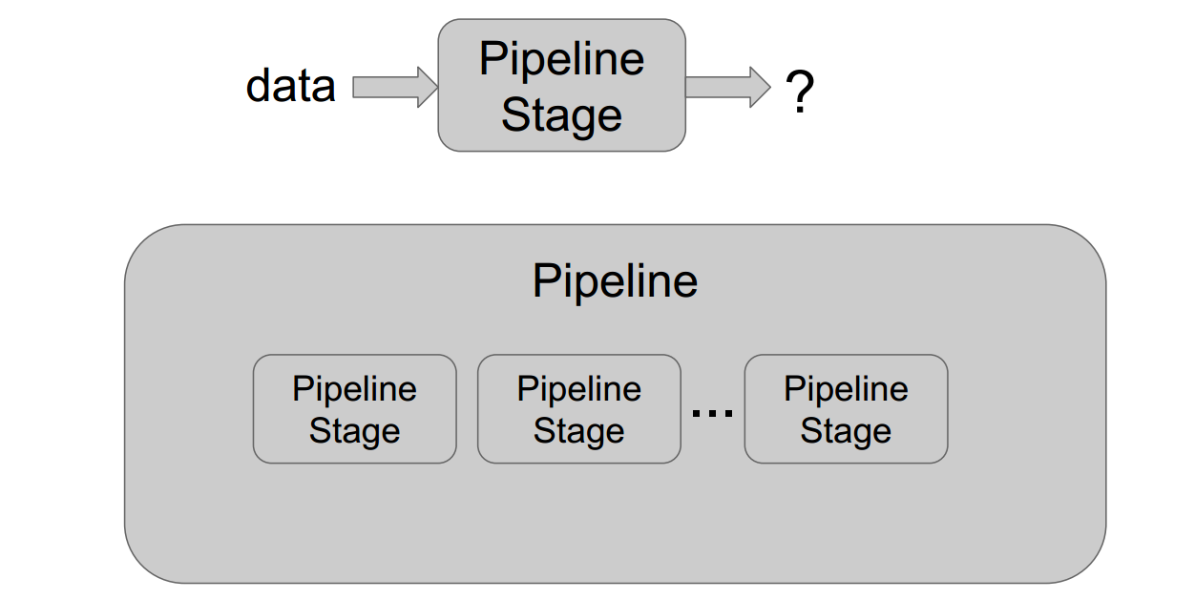
Spark ML Pipelines

Slide 9
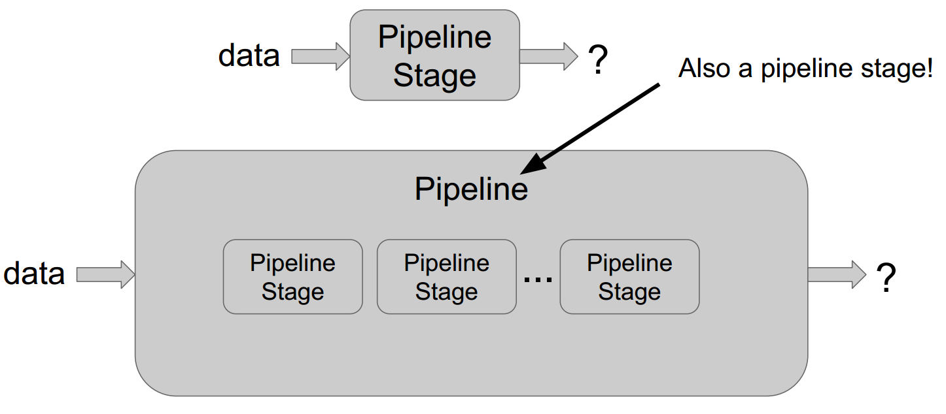
Recursive Modules

Slide 10
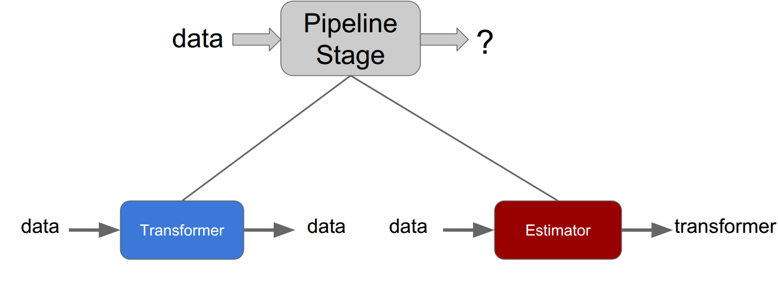
Two Types of Pipeline Stages

Slide 11
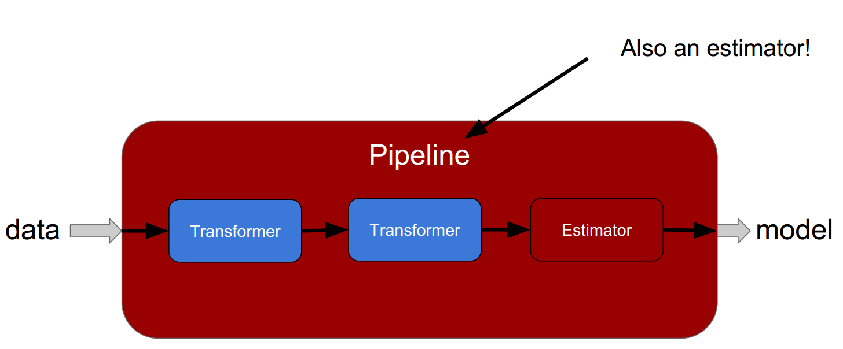
Pipelines are Estimators

Slide 12
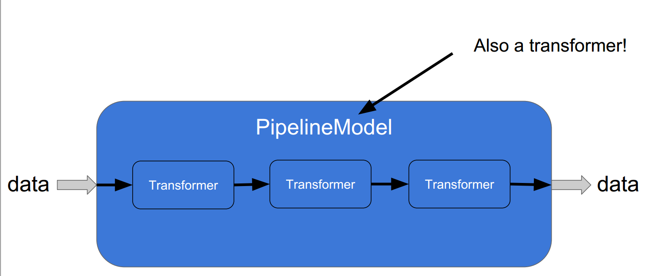
Pipelines are also Transformers

Slide 13
ML: Transformer (featurizer)
A Transformer is a class which transforms one DataFrame to another
Stateless
A transform implements transform()
Examples:
HasingTF
Bucketizer
Binarizer
PipelineModel
Notes:
Objective: This slide describes the types of algorithms MLlib supports.
Talking point:
There are three types of machine learning algorithms: supervised, unsupervised, and recommendation.

Slide 14
ML: Estimator
An Estimator is a class which takes a DataFrame and produce a Transformer
An estimator implements fit()
Examples:
IDF
CrossValidator
MultilayerPerceptronClassifier
Notes:
Objective: This slide describes the types of algorithms MLlib supports.
Talking point:
There are three types of machine learning algorithms: supervised, unsupervised, and recommendation.

Slide 15
ML Pipelines
A Pipeline is an estimator that contains stages representing a reusable workflow
The pipeline stages are a mix of estimators and transformers
Load data
Extract features
Train model
Evaluate
Notes:
Objective: This slide describes the types of algorithms MLlib supports.
Talking point:
There are three types of machine learning algorithms: supervised, unsupervised, and recommendation.

Slide 16
Complex Multi-Data Source Pipelines
Datasource 2
Datasource 1
Datasource 3
Train model 1
Extract features
Extract features
Train model 2
Feature transform 1
Ensemble
Feature transform 2
Evaluate
Feature transform 3
Notes:
Objective: This slide describes the types of algorithms MLlib supports.
Talking point:
There are three types of machine learning algorithms: supervised, unsupervised, and recommendation.

Slide 17
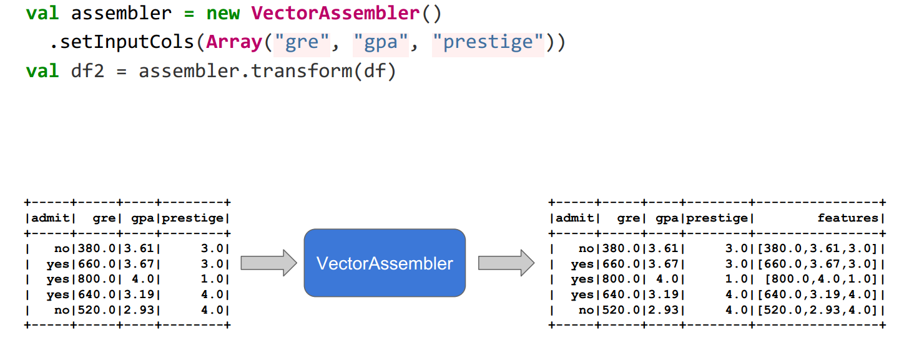
Feature Transformers

Slide 18
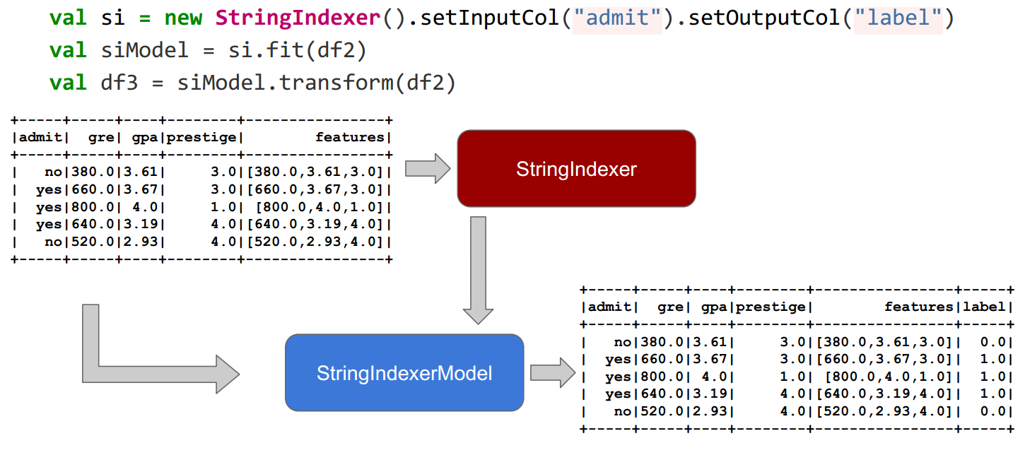
Train a Classifier on Transformed Data

Slide 19
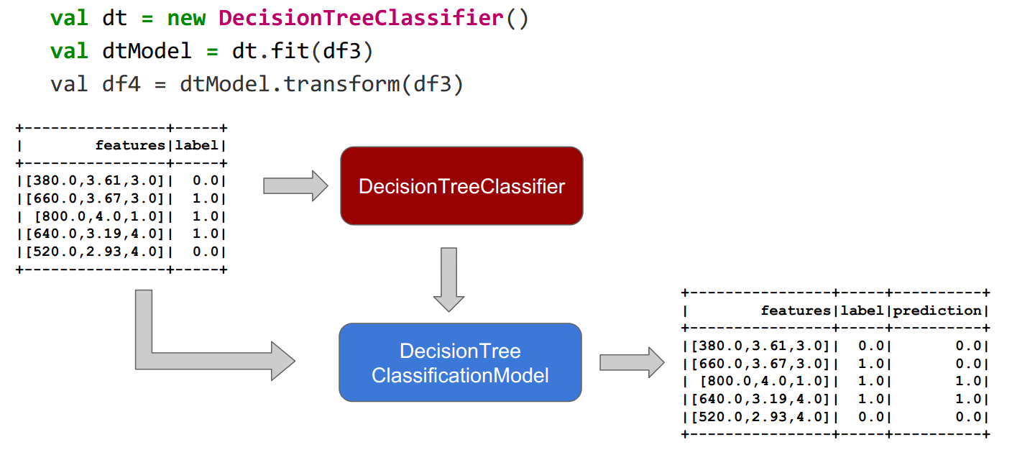
Train a Classifier on Transformed Data

Slide 20
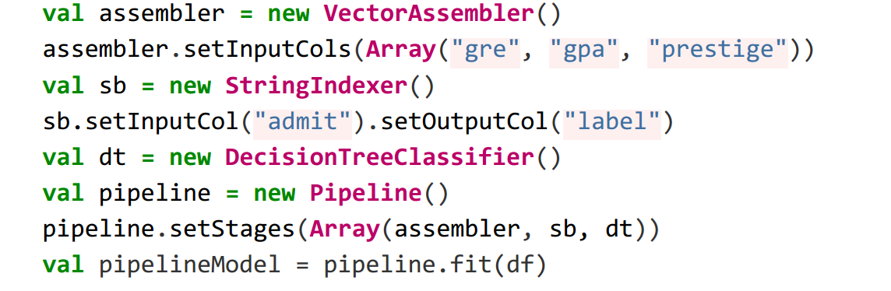
Put that Into Your Pipeline and …
Keeping track of intermediate data and calling fit/transform on every stage is way too much work
This problem is worse when more stages are used
Use a pipeline instead!

Slide 21
Supported algorithms

Slide 22
Supported types of algorithms
Type | Algorithms
Supervised | Classification and regression: Linear models (SVMs) logistic regression and linear regression Naïve Bayes Decision trees Ensembles of trees (random forest, gradient-boosted trees) Isotonic regression
Unsupervised | Clustering: k-means and streaming k-means Gaussian mixture Power iteration clustering (PIC) Latent Dirichlet Allocation (LDA)
Recommendation | Collaborative filtering: Alternating least squares (ALS)
Notes:
Objective: This slide describes the types of algorithms MLlib supports.
Talking point:
There are three types of machine learning algorithms: supervised, unsupervised, and recommendation.

Slide 23
Demo
Predictive analysis on food inspection data using MLlib with Spark on HDInsight

Slide 24
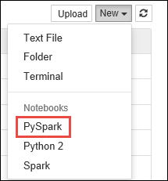
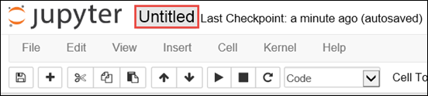
from pyspark.ml import Pipeline
from pyspark.ml.classification import LogisticRegression
from pyspark.ml.feature import HashingTF, Tokenizer
from pyspark.sql import Row
from pyspark.sql.functions import UserDefinedFunction
from pyspark.sql.types import *
Notes:
Objective: This slide demonstrates how to build machine learning applications using Apache Spark on Azure HDInsight.
Instructions:
Start building a machine learning application using Spark MLlib
From the Azure Portal, from the startboard, click the tile for your Spark cluster (if you pinned it to the startboard). You can also navigate to your cluster under Browse All > HDInsight Clusters.
From the Spark cluster blade, click Quick Links, and then from the Cluster Dashboard blade, click Jupyter Notebook. If prompted, enter the admin credentials for the cluster.
Note: You may also reach the Jupyter Notebook for your cluster by opening the following URL in your browser. Replace CLUSTERNAME with the name of your cluster: https://CLUSTERNAME.azurehdinsight.net/jupyter
<<animation>> Create a new notebook. Click New, and then click PySpark.
<<animation>> A new notebook is created and opened with the name Untitled.pynb. Click the notebook name at the top, and enter a friendly name.
<<animation>> Because you created a notebook using the PySpark kernel, you do not need to create any contexts explicitly. The Spark, SQL, and Hive contexts will be automatically created for you when you run the first code cell. You can start building your machine learning application by importing the types required for this scenario. To do so, place the cursor in the cell and press SHIFT + ENTER.

Slide 25
# -----------------
# THIS IS AN OUTPUT
# -----------------
[['413707',
'LUNA PARK INC',
'LUNA PARK DAY CARE',
'2049789',
"Children's Services Facility",
'Risk 1 (High)',
'3250 W FOSTER AVE ',
'CHICAGO',
'IL',
'60625',
'09/21/2010',
'License-Task Force',
'Fail',
'24. DISH WASHING FACILITIES: PROPERLY DESIGNED, CONSTRUCTED, MAINTAINED, INSTALLED, LOCATED AND OPERATED - Comments: All dishwashing machines must be of a type that complies with all requirements of the plumbing section of the Municipal Code of Chicago and Rules and Regulation of the Board of Health. OBSEVERD THE 3 COMPARTMENT SINK BACKING UP INTO THE 1ST AND 2ND COMPARTMENT WITH CLEAR WATER AND SLOWLY DRAINING OUT. INST NEED HAVE IT REPAIR. CITATION ISSUED, SERIOUS VIOLATION 7-38-030 H000062369-10 COURT DATE 10-28-10 TIME 1 P.M. ROOM 107 400 W. SURPERIOR. | 36. LIGHTING: REQUIRED MINIMUM FOOT-CANDLES OF LIGHT PROVIDED, FIXTURES SHIELDED - Comments: Shielding to protect against broken glass falling into food shall be provided for all artificial lighting sources in preparation, service, and display facilities. LIGHT SHIELD ARE MISSING UNDER HOOD OF COOKING EQUIPMENT AND NEED TO REPLACE LIGHT UNDER UNIT. 4 LIGHTS ARE OUT IN THE REAR CHILDREN AREA,IN THE KINDERGARDEN CLASS ROOM. 2 LIGHT ARE OUT EAST REAR, LIGHT FRONT WEST ROOM. NEED TO REPLACE ALL LIGHT THAT ARE NOT WORKING. | 35. WALLS, CEILINGS, ATTACHED EQUIPMENT CONSTRUCTED PER CODE: GOOD REPAIR, SURFACES CLEAN AND DUST-LESS CLEANING METHODS - Comments: The walls and ceilings shall be in good repair and easily cleaned. MISSING CEILING TILES WITH STAINS IN WEST,EAST, IN FRONT AREA WEST, AND BY THE 15MOS AREA. NEED TO BE REPLACED. | 32. FOOD AND NON-FOOD CONTACT SURFACES PROPERLY DESIGNED, CONSTRUCTED AND MAINTAINED - Comments: All food and non-food contact equipment and utensils shall be smooth, easily cleanable, and durable, and shall be in good repair. SPLASH GUARDED ARE NEEDED BY THE EXPOSED HAND SINK IN THE KITCHEN AREA | 34. FLOORS: CONSTRUCTED PER CODE, CLEANED, GOOD REPAIR, COVING INSTALLED, DUST-LESS CLEANING METHODS USED - Comments: The floors shall be constructed per code, be smooth and easily cleaned, and be kept clean and in good repair. INST NEED TO ELEVATE ALL FOOD ITEMS 6INCH OFF THE FLOOR 6 INCH AWAY FORM WALL. ',
'41.97583445690982',
'-87.7107455232781',
'(41.97583445690982, -87.7107455232781)']]
df.show(5)
def csvParse(s):
import csv
from StringIO import StringIO
sio = StringIO(s)
value = csv.reader(sio).next()
sio.close()
return value
inspections = sc.textFile('wasb:///HdiSamples/HdiSamples/FoodInspectionData/Food_Inspections1.csv')\
.map(csvParse)
# -----------------
# THIS IS AN OUTPUT
# -----------------
+------+--------------------+-------+--------------------+
| id| name|results| violations|
+------+--------------------+-------+--------------------+
|413707| LUNA PARK INC| Fail|24. DISH WASHING ...|
|391234| CAFE SELMARIE| Fail|2. FACILITIES TO ...|
|413751| MANCHU WOK| Pass|33. FOOD AND NON-...|
|413708|BENCHMARK HOSPITA...| Pass| |
|413722| JJ BURGER| Pass| |
+------+--------------------+-------+--------------------+
schema = StructType([
StructField("id", IntegerType(), False),
StructField("name", StringType(), False),
StructField("results", StringType(), False),
StructField("violations", StringType(), True)])
df = sqlContext.createDataFrame(inspections.map(lambda l: (int(l[0]), l[1], l[12], l[13])) , schema)
df.registerTempTable('CountResults')
inspections.take(1)
Notes:
Objective: This slide demonstrates how to build machine learning applications using Apache Spark on Azure HDInsight.
Instructions:
We already have a SQLContext that we can use to perform transformations on structured data. The first task is to load the sample data ((Food_Inspections1.csv)) into a Spark SQL dataframe. The snippets below assume that the data is already uploaded to the default storage container associated with the Spark cluster.
Because the raw data is in a CSV format, we need to use the Spark context to pull every line of the file into memory as unstructured text; then, you use Python's CSV library to parse each line individually.
We now have the CSV file as an RDD. Let us retrieve one row from the RDD to understand the schema of the data.
You should see an output like the following: <<animation on click>>
The above output gives us an idea of the schema of the input file; the file includes the name of every establishment, the type of establishment, the address, the data of the inspections, and the location, among other things. Let's select a few columns that will be useful for our predictive analysis and group the results as a dataframe, which we then use to create a temporary table.
We now have a dataframe, df on which we can perform our analysis. We also have a temporary table call CountResults. We've included 4 columns of interest in the dataframe: id, name, results, and violations.
Let's get a small sample of the data:
You should see an output like the following: <<animation on click>>

Slide 26
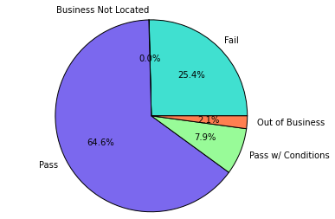
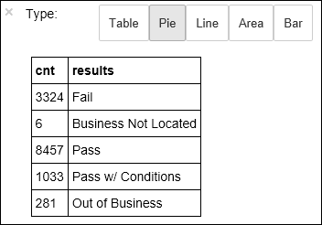
# -----------------
# THIS IS AN OUTPUT
# -----------------
[Row(label=0.0, violations=u"41. PREMISES MAINTAINED FREE OF LITTER, UNNECESSARY ARTICLES, CLEANING EQUIPMENT PROPERLY STORED - Comments: All parts of the food establishment and all parts of the property used in connection with the operation of the establishment shall be kept neat and clean and should not produce any offensive odors. REMOVE MATTRESS FROM SMALL DUMPSTER. | 35. WALLS, CEILINGS, ATTACHED EQUIPMENT CONSTRUCTED PER CODE: GOOD REPAIR, SURFACES CLEAN AND DUST-LESS CLEANING METHODS - Comments: The walls and ceilings shall be in good repair and easily cleaned. REPAIR MISALIGNED DOORS AND DOOR NEAR ELEVATOR. DETAIL CLEAN BLACK MOLD LIKE SUBSTANCE FROM WALLS BY BOTH DISH MACHINES. REPAIR OR REMOVE BASEBOARD UNDER DISH MACHINE (LEFT REAR KITCHEN). SEAL ALL GAPS. REPLACE MILK CRATES USED IN WALK IN COOLERS AND STORAGE AREAS WITH PROPER SHELVING AT LEAST 6' OFF THE FLOOR. | 38. VENTILATION: ROOMS AND EQUIPMENT VENTED AS REQUIRED: PLUMBING: INSTALLED AND MAINTAINED - Comments: The flow of air discharged from kitchen fans shall always be through a duct to a point above the roofline. REPAIR BROKEN VENTILATION IN MEN'S AND WOMEN'S WASHROOMS NEXT TO DINING AREA. | 32. FOOD AND NON-FOOD CONTACT SURFACES PROPERLY DESIGNED, CONSTRUCTED AND MAINTAINED - Comments: All food and non-food contact equipment and utensils shall be smooth, easily cleanable, and durable, and shall be in good repair. REPAIR DAMAGED PLUG ON LEFT SIDE OF 2 COMPARTMENT SINK. REPAIR SELF CLOSER ON BOTTOM LEFT DOOR OF 4 DOOR PREP UNIT NEXT TO OFFICE.")]
# -----------------
# THIS IS AN OUTPUT
# -----------------
+--------------------+
| results|
+--------------------+
| Fail|
|Business Not Located|
| Pass|
| Pass w/ Conditions|
| Out of Business|
+--------------------+
def labelForResults(s):
if s == 'Fail':
return 0.0
elif s == 'Pass w/ Conditions' or s == 'Pass':
return 1.0
else:
return -1.0
label = UserDefinedFunction(labelForResults, DoubleType())
labeledData = df.select(label(df.results).alias('label'), df.violations).where('label >= 0')
%%local
%matplotlib inline
import matplotlib.pyplot as plt
labels = countResultsdf['results']
sizes = countResultsdf['cnt']
colors = ['turquoise', 'seagreen', 'mediumslateblue', 'palegreen', 'coral']
plt.pie(sizes, labels=labels, autopct='%1.1f%%', colors=colors)
plt.axis('equal')
%%sql -o countResultsdf
SELECT results, COUNT(results) AS cnt FROM CountResults GROUP BY results
labeledData.take(1)
Notes:
Objective: This slide demonstrates how to build machine learning applications using Apache Spark on Azure HDInsight.
Instructions:
Let's start to get a sense of what our dataset contains. For example, what are the different values in the results column?
df.select('results').distinct().show()
You should see an output like the following: <<animation on click>>
A quick visualization can help us reason about the distribution of these outcomes. We already have the data in a temporary table CountResults. You can run the following SQL query against the table to get a better understanding of how the results are distributed.
<<animation on click>> The %%sql magic followed by -o countResultsdf ensures that the output of the query is persisted locally on the Jupyter server (typically the headnode of the cluster). The output is persisted as a Pandas dataframe with the specified name countResultsdf.
You should see an output like the following: <<animation on click>>
For more information about the %%sql magic, as well as other magics available with the PySpark kernel, see Kernels available on Jupyter notebooks with Spark HDInsight clusters.
You can also use Matplotlib, a library used to construct visualization of data, to create a plot. Because the plot must be created from the locally persisted countResultsdf dataframe, the code snippet must begin with the %%local magic. This ensures that the code is run locally on the Jupyter server. <<animation on click>>
You should see an output like the following: <<animation on click>>
You can see that there are 5 distinct results that an inspection can have:
Business not located
Fail
Pass
Pss w/ conditions, and
Out of Business
Let us develop a model that can guess the outcome of a food inspection, given the violations. Since logistic regression is a binary classification method, it makes sense to group our data into two categories: Fail and Pass. A "Pass w/ Conditions" is still a Pass, so when we train the model, we will consider the two results equivalent. Data with the other results ("Business Not Located", "Out of Business") are not useful so we will remove them from our training set. This should be okay since these two categories make up a very small percentage of the results anyway.
Let us go ahead and convert our existing dataframe(df) into a new dataframe where each inspection is represented as a label-violations pair. In our case, a label of 0.0 represents a failure, a label of 1.0 represents a success, and a label of -1.0 represents some results besides those two. We will filter those other results out when computing the new data frame. <<animation on click>>
Let's retrieve one row from the labeled data to see what it looks like. <<animation on click>>
You should see an output like the following: <<animation on click>>

Slide 27
Demo
Analyzing building temperature using HVAC data

Slide 28
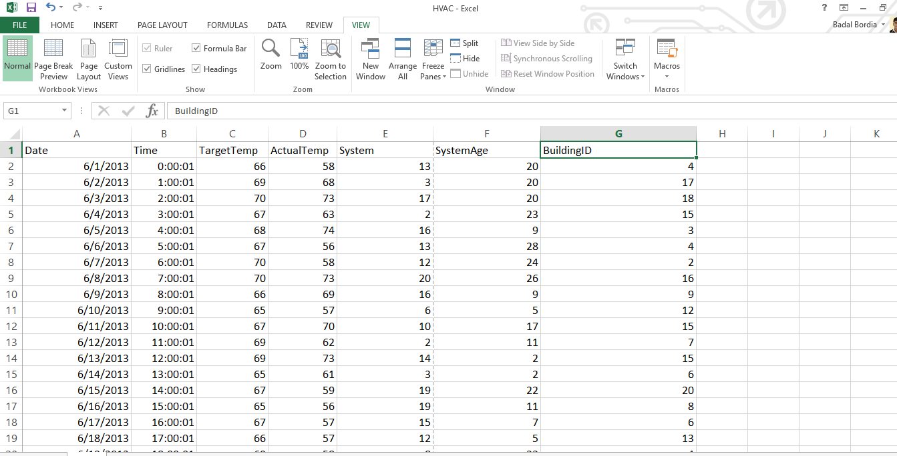
Notes:
Objective: This slide demonstrates how to build machine learning applications using Apache Spark on Azure HDInsight.
Instructions:
In the demo we will learn how to build a machine learning application using an Apache Spark cluster in HDInsight. This demo shows how to use the Jupyter notebook available with the cluster to build and test our application. The application uses the sample hvac.csv data that is available on all clusters by default. Before we start building the application, let us understand the structure of the data and the kind of analysis we will do on the data.
Download and open the CSV file to get a snapshot of the data. This file is available on all HDInsight clusters by default at \HdiSamples\SensorSampleData\hvac.
The data shows the target temperature and the actual temperature of a building that has HVAC systems installed. Let's assume the System column represents the system ID and the SystemAge column represents the number of years the HVAC system has been in place at the building. We use this data to predict whether a building will be hotter or colder based on the target temperature, given a system ID and system age.

Slide 29
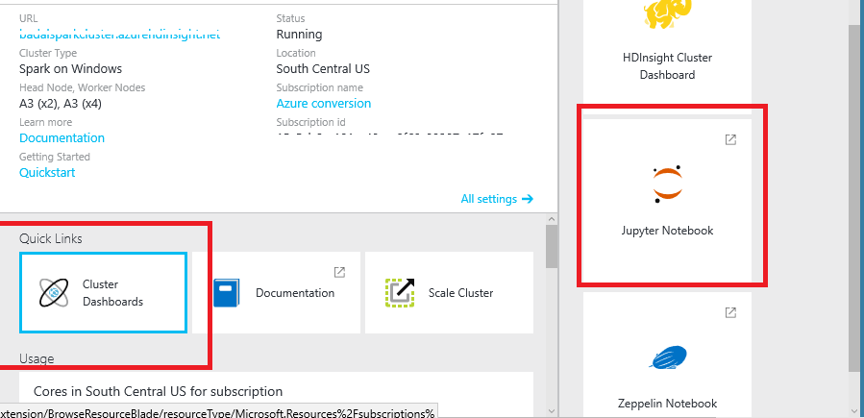
Notes:
Objective: This slide continues the demo for how to build machine learning applications using Apache Spark on Azure HDInsight.
Instructions:
Now we will write a machine learning application using Spark MLlib. For this we will use a Jupyter notebook.
Navigate to your Azure Spark cluster blade, and then from the Cluster Dashboard blade, open Jupyter Notebook. You need to provide the admin credentials for the cluster to open the notebook. You need to create a new notebook from the Python 2.

Slide 30
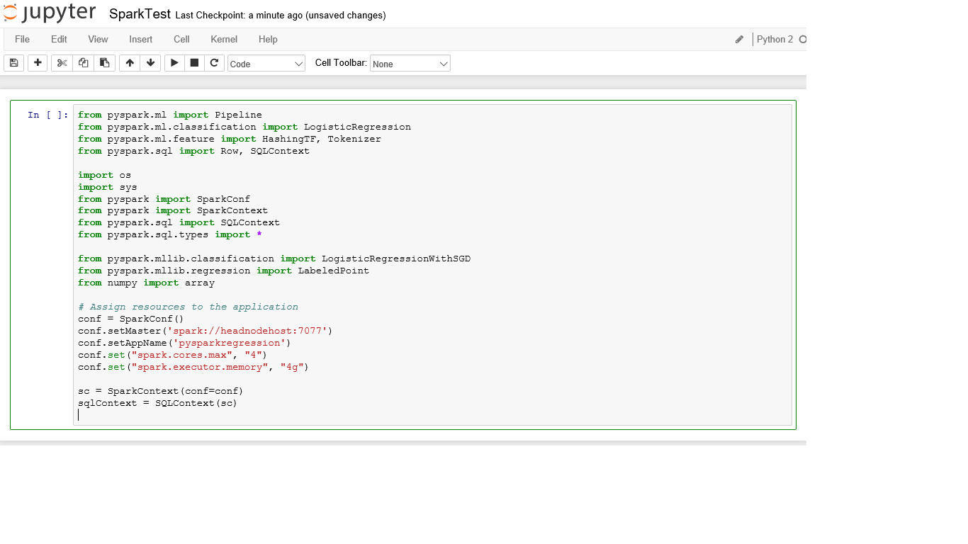
Notes:
Objective: This slide continues the demo for how to build machine learning applications using Apache Spark on Azure HDInsight.
Instructions:
Start building your machine learning application. In this application we use a Spark machine learning pipeline to perform a document classification. In the pipeline, we split the document into words, convert the words into a numerical feature vector, and finally build a prediction model using the feature vectors and labels.
To start building the application, first import the required modules and assign resources to the application.
Every time you run a job in Jupyter, your web browser window title will show a (Busy) status along with the notebook title. You will also see a solid circle next to the Python 2 text in the top-right corner. After the job completes, this will change to a hollow circle.

Slide 31
# List the structure of data. Since the data will be loaded as an array, this structure clarifies each element’s purpose.
# 0 Date
# 1 Time
# 2 TargetTemp
# 3 ActualTemp
# 4 System
# 5 SystemAge
# 6 BuildingID
LabeledDocument = Row("BuildingID", "SystemInfo", "label")
# Define a function that parses the raw CSV file and returns an object of type (LabeledDocument).
def parseDocument(line):
values = [str(x) for x in line.split(',')]
if (values[3] > values[2]):
hot = 1.0
else:
hot = 0.0
textValue = str(values[4]) + " " + str(values[5])
return LabeledDocument((values[6]), textValue, hot)
# Load the raw hvac.csv file, parse it using the function.
data = sc.textFile("wasb:///HdiSamples/SensorSampleData/hvac/HVAC.csv")
documents = data.filter(lambda s: "Date" not in s).map(parseDocument)
training = documents.toDF()
Notes:
Objective: This slide continues the demo for how to build machine learning applications using Apache Spark on Azure HDInsight.
Instructions:
Now we load the data (hvac.csv), parse it, and use it to train the model. To do this, first we define a function that parses the raw CSV file and returns an object of type (LabeledDocument). This function checks whether the actual temperature of the building is greater than the target temperature. If the actual temperature is greater, the building is hot, denoted by the value 1.0. If the actual temperature is lesser, the building is cold, denoted by the value 0.0.
Then we load the raw hvac.csv file, parse it using the function.

Slide 32
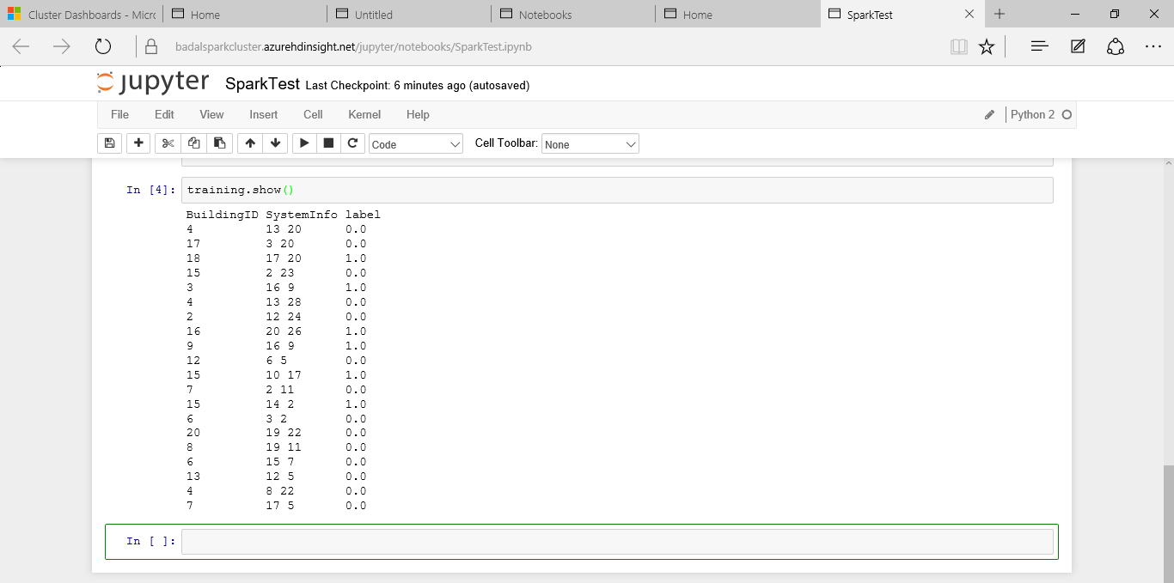
Notes:
Objective: This slide continues the demo for how to build machine learning applications using Apache Spark on Azure HDInsight.
Instructions:
Now next we will configure the Spark machine learning pipeline that consists of three stages: tokenizer, hashingTF, and lr. The spark.ml package aims to provide a uniform set of high-level APIs built on top of DataFrames that help users create and tune practical machine learning pipelines.
Then we fit the pipeline to the training document.
Now we will verify the training document to checkpoint your progress with the application. Go back and verify the output against the raw CSV file. For example, the first row the CSV file has this data: Target Temp: 66 and Actual temp: 58. Notice how the actual temperature is less than the target temperature, suggesting the building is cold. Hence in the training output, the value for label in the first row is 0.0, which means the building is not hot.

Slide 33
# SystemInfo is a combination of system IDs followed by system age.
Document = Row("id", "SystemInfo")
test = sc.parallelize([(1L, "20 25"),
(2L, "4 15"),
(3L, "16 9"),
(4L, "9 22"),
(5L, "17 10"),
(6L, "7 22")]) \
.map(lambda x: Document(*x)).toDF()
# Make predictions on test documents and print columns of interest.
prediction = model.transform(test)
selected = prediction.select("SystemInfo", "prediction", "probability")
for row in selected.collect():
print row
Notes:
Objective: This slide continues the demo for how to build machine learning applications using Apache Spark on Azure HDInsight.
Instructions:
Next we will prepare a data set to run the trained model against. To do so, we would pass on a system ID and system age (denoted as SystemInfo in the training output), and the model would predict whether the building with that system ID and system age would be hotter (denoted by 1.0) or cooler (denoted by 0.0).
Finally, we make predictions on the test data.
From the first row in the prediction, you can see that for an HVAC system with ID 20 and system age of 25 years, the building will be hot (prediction=1.0). The first value for DenseVector (0.49999) corresponds to the prediction 0.0 and the second value (0.5001) corresponds to the prediction 1.0. In the output, even though the second value is only marginally higher, the model shows prediction=1.0.

Slide 34
Hands-on lab
Building machine learning applications

Slide 35

© 2016 Microsoft Corporation. All rights reserved. Microsoft, Windows, Windows Vista and other product names are or may be registered trademarks and/or trademarks in the U.S. and/or other countries.
The information herein is for informational purposes only and represents the current view of Microsoft Corporation as of the date of this presentation. Because Microsoft must respond to changing market conditions, it should not be interpreted to be a commitment on the part of Microsoft, and Microsoft cannot guarantee the accuracy of any information provided after the date of this presentation. MICROSOFT MAKES NO WARRANTIES, EXPRESS, IMPLIED OR STATUTORY, AS TO THE INFORMATION IN THIS PRESENTATION.

